Slide 1
Male Circumcision & HIV Prevention
MTN-025 (HOPE Study)
Community Education Presentation

Slide 2
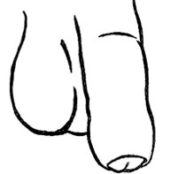
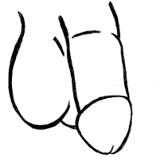
What is Male Circumcision?
The term
“male circumcision”
refers to cutting the foreskin off the penis.
Notes:
Across the world, circumcision is done for religious, cultural, medical, and other reasons. About 30% of men worldwide are circumcised.

Slide 3
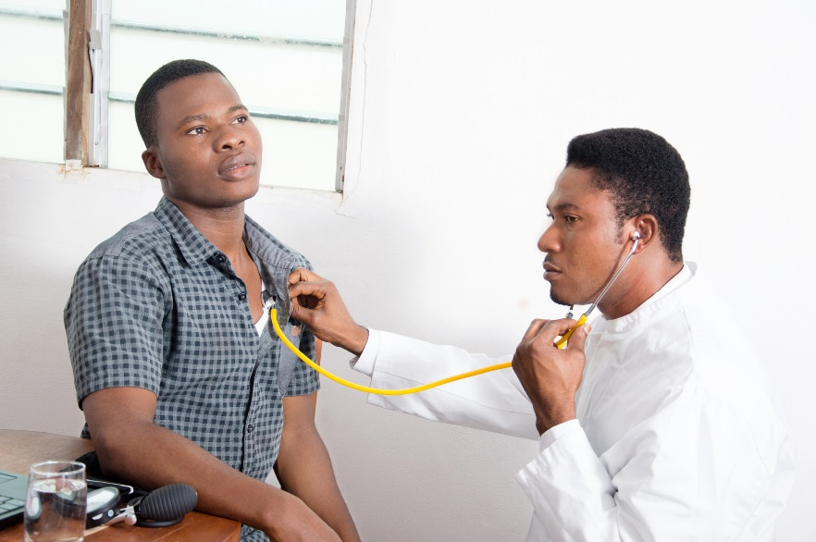
The term “medical male circumcision” refers to the surgical removal of the foreskin by a trained health professional.
What is Male Circumcision?
Notes:
There are other forms of circumcision, called “traditional circumcision,” that involve different types of cutting of the foreskin, often done by people who are not health professionals.

Slide 4
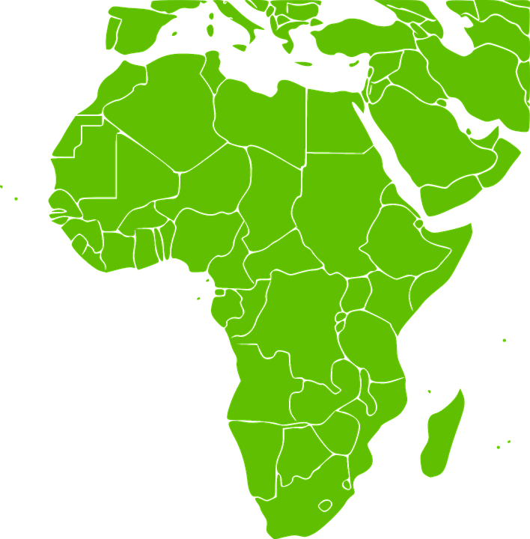
What Is Known about Male Circumcision and HIV Prevention?
Three (3) research studies recently tested whether medical male circumcision could prevent men from getting HIV through sex.
Notes:
These studies included over 10,000 men from Kenya, Uganda, and South Africa.

Slide 5
The studies found that men who were circumcised were about half as likely to get HIV as men who were not circumcised. In other words, circumcision was found to be about 50% effective in preventing men from getting HIV.
What Is Known about Male Circumcision and HIV Prevention?
Notes:
Another way to explain this is to think about 10 men who might get HIV from having unprotected sex with an HIV-infected woman. Among these 10 men, circumcision would be expected to prevent 5 of them from getting HIV.

Slide 6
Medical male circumcision is an effective way for men to reduce their chances of getting HIV. However, circumcision does not provide complete protection against HIV. Because of this, circumcision should be used in addition to other known ways of preventing HIV, including using condoms correctly and consistently.
What Is Known about Male Circumcision and HIV Prevention?

Slide 7
What Else Is Known about Male Circumcision?
Male circumcision does not protect women from getting HIV.
Men who have HIV and are circumcised can pass HIV to their partners.
Notes:
There is another important fact about male circumcision that men and women should know.
In fact, a man is more likely to pass HIV to his partner during the time soon after circumcision, before his wound has healed.

Slide 8
What Else Is Known about Male Circumcision?
Because of this, a man who has recently been circumcised must wait for his wound to heal completely before having sex.

Slide 9
If you have questions or need more information, please visit the study clinic.

